Slide 1
DB Applications
Relational Algebra

Slide 2
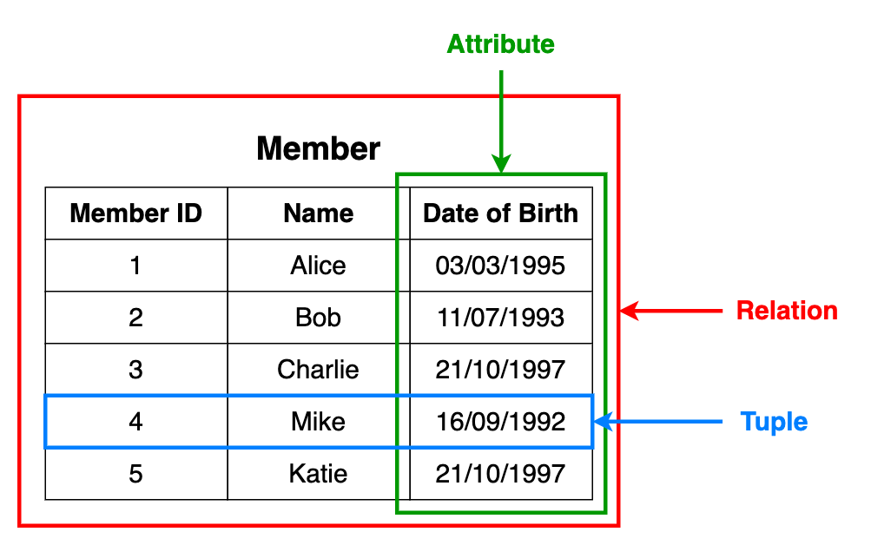
What is Relational Algebra?
According to Wikipedia:
Relational algebra is a family of algebras with a well-founded semantics used for modelling the data stored in relational databases and defining queries on it.

Slide 3
Relational operators
Projection
Selection
Rename
Cross product
Natural join
Conditional join
Union
Intersection
Set difference

Slide 4
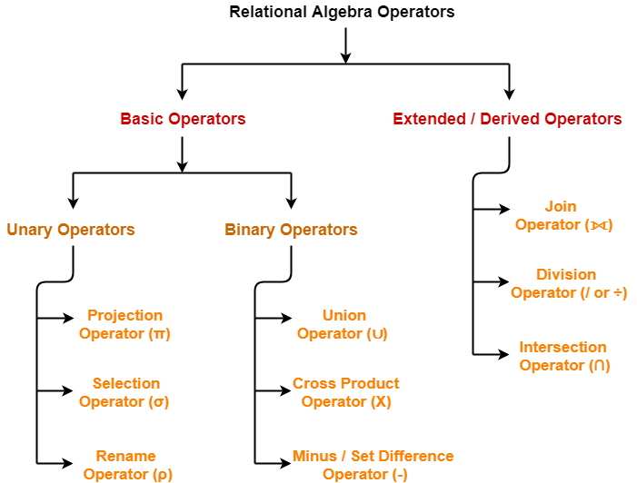
Relational operators

Slide 5
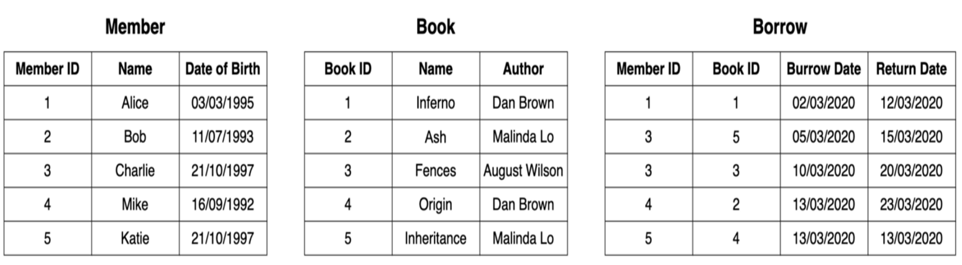
Examples
We have a
Member table (details about members),
Book table (details about books)
Borrow table (details about borrowed books).

Slide 6
Relational operators
Projection(π)
Selection
Rename
Cross product
Natural join
Conditional join
Union
Intersection
Set difference

Slide 7
Projection(π)
Projection (π)
Projection is used to select the required columns of data from a relation.
Note that projection removes duplicate data (tuples).

Slide 8
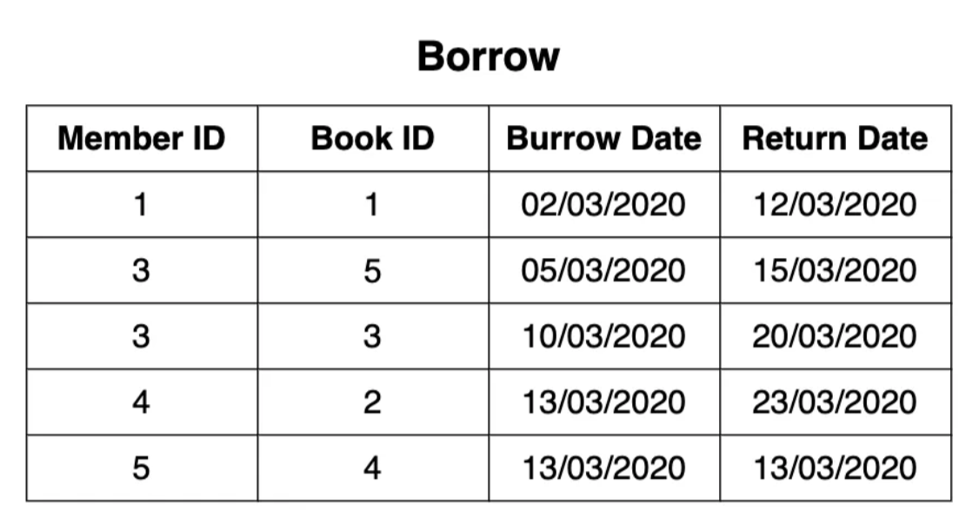
Projection(π)
Query: Member IDs of members who have borrowed books.

Slide 9
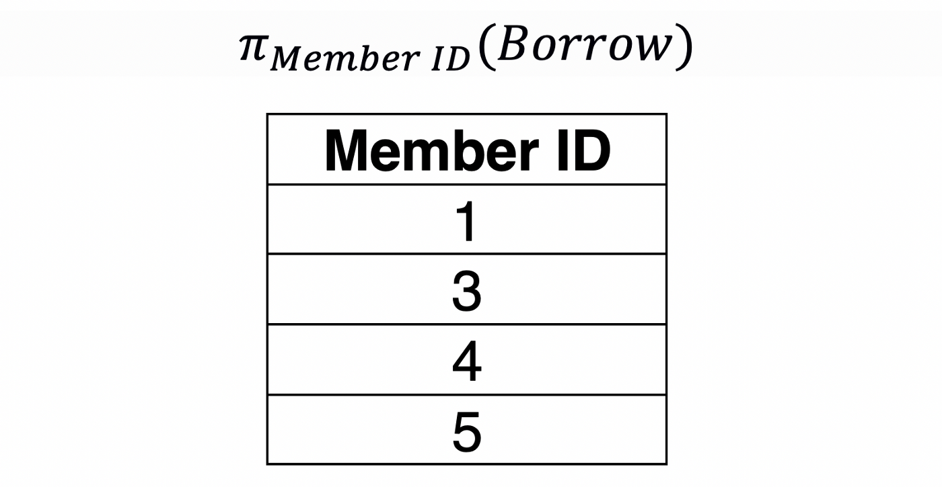
Projection(π)
Query: Member IDs of members who have borrowed books.

Slide 10
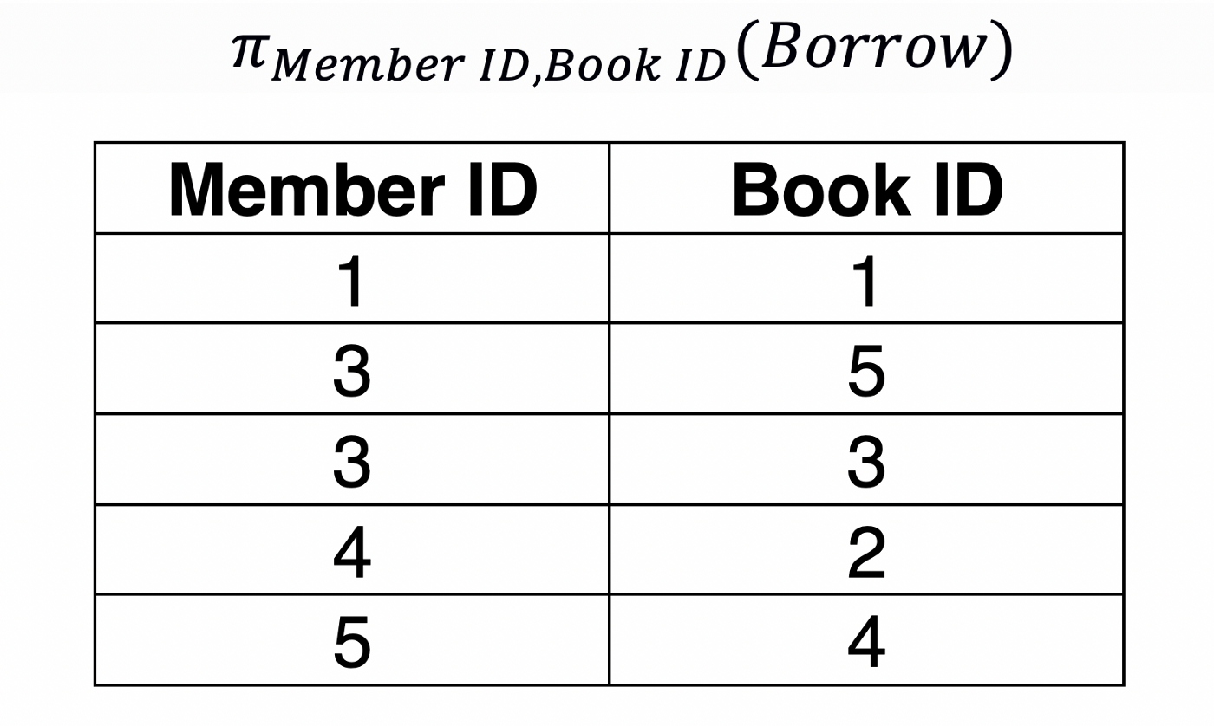
Projection(π)
Query: Member IDs and the Book IDs that the member have borrowed books.
subset table

Slide 11
Relational operators
Projection(π)
Selection (σ)
Rename
Cross product
Natural join
Conditional join
Union
Intersection
Set difference

Slide 12
Selection (σ)
Selection (σ)
Selection is used to select the required tuples of data from a relation.
During selection, we can specify certain conditions that the data must satisfy.

Slide 13
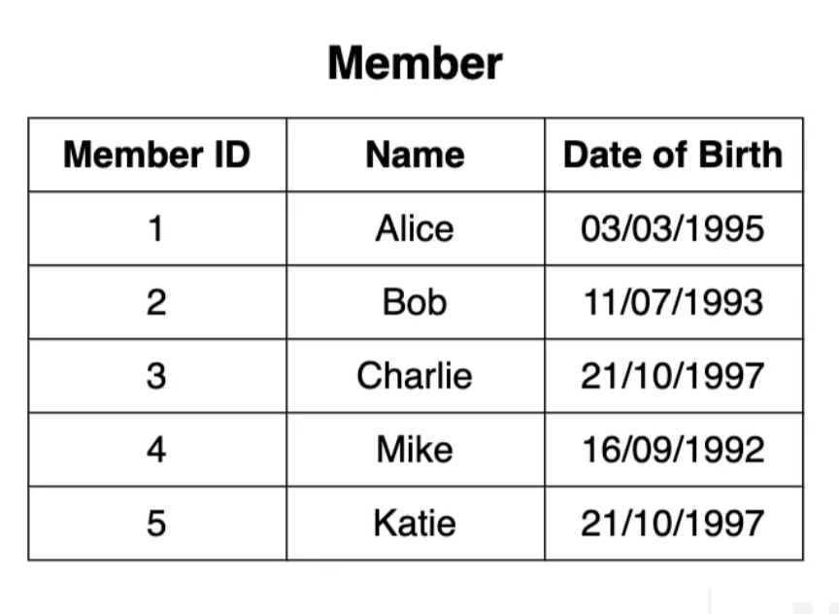
Selection (σ)
Query: Details of the members who were born on 21/10/1997.

Slide 14
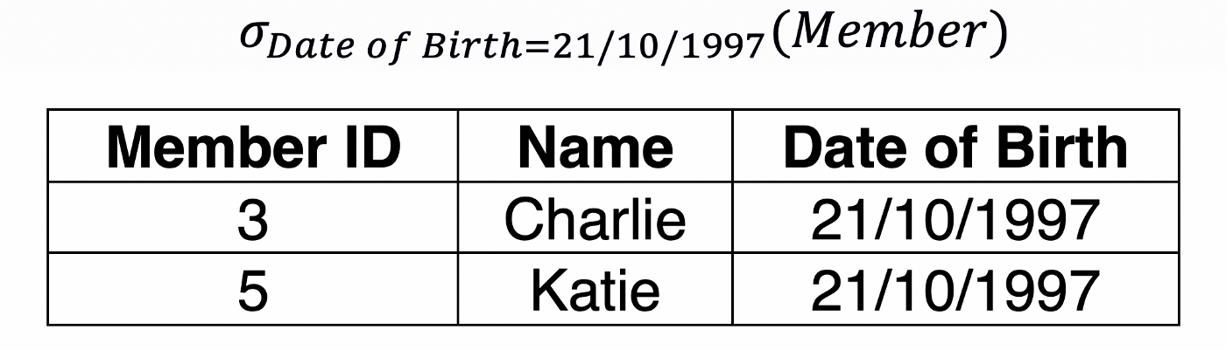
Selection (σ)
Query: Details of the members who were born on 21/10/1997.

Slide 15
Relational operators
Projection(π)
Selection (σ)
Rename (ρ)
Cross product
Natural join
Conditional join
Union
Intersection
Set difference

Slide 16
Rename (ρ)
Rename (ρ)
Rename operation allows renaming a certain output relation.

Slide 17
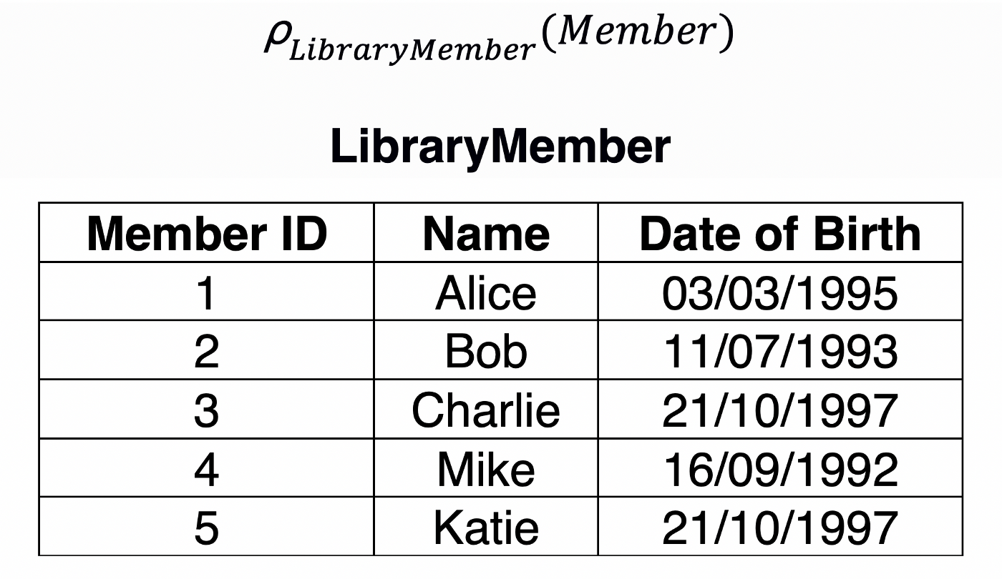
Rename (ρ)
Query: Details of the members who were born on 21/10/1997.

Slide 18
Relational operators
Projection(π)
Selection (σ)
Rename (ρ)
Cross product (✕)
Natural join
Conditional join
Union
Intersection
Set difference

Slide 19
Cross product (✕)
Cross product (✕)
Cross product is used to combine data from two different relations into one combined relation.
If we consider two relations; A with n tuples and B with m tuples, A ✕ B will consist of n.m tuples.

Slide 20
Cross product (✕)
Query: Member ✕ Borrow
✕

Slide 21
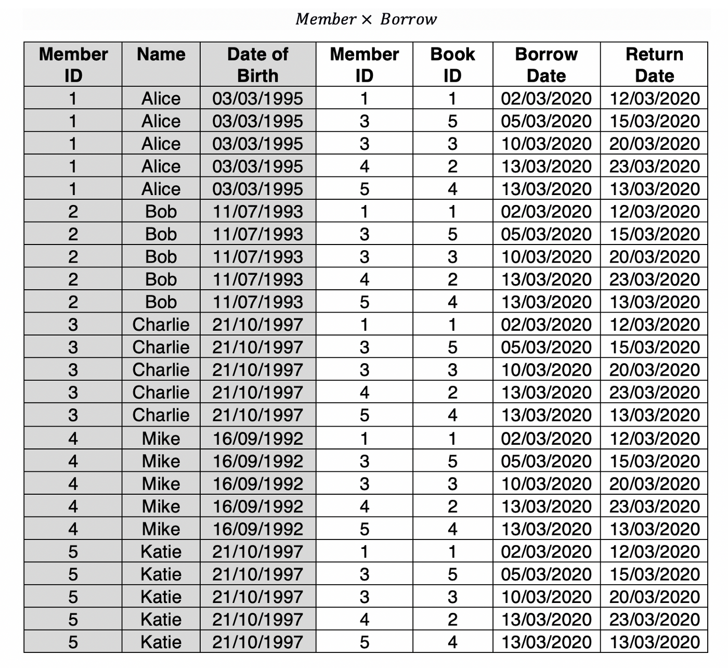
Cross product (✕)
Query: Member ✕ Borrow
✕

Slide 22
Cross product (✕)
Query: Member ✕ Borrow
✕
Note that Member relation has 5 tuples and Burrow relation has 5 tuples.
Hence Member ✕ Borrow has 5✕5 = 25 tuples.

Slide 23
Relational operators
Projection(π)
Selection (σ)
Rename (ρ)
Cross product (✕)
Natural join (⋈)
Conditional join
Union
Intersection
Set difference

Slide 24
Natural join (⋈)
Natural join (⋈)
Natural join between two or more relations will result in all the combination of tuples where they have equal values for the common attribute.

Slide 25
Natural join (⋈)
Query: Member ⋈ Borrow
⋈

Slide 26
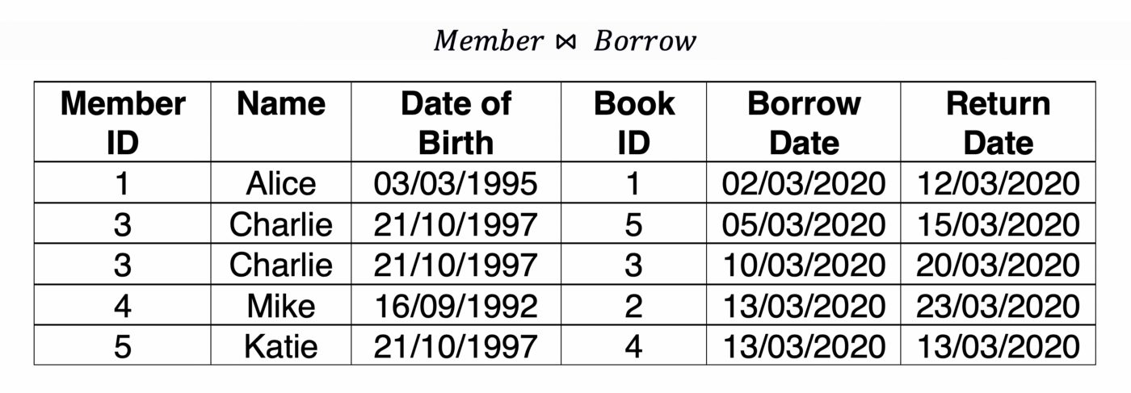
Natural join (⋈)
Query: Member ⋈ Borrow
⋈

Slide 27
Relational operators
Projection(π)
Selection (σ)
Rename (ρ)
Cross product (✕)
Natural join (⋈)
Conditional join (⋈c)
Union
Intersection
Set difference

Slide 28
Conditional join (⋈c)
Conditional join (⋈c)
Conditional join is similar to the natural join but in the conditional join, we can specify any join condition with the operators greater than, less than, equal or not equal.
You can combine conditions as well with AND (^) and OR (v) operators.

Slide 29
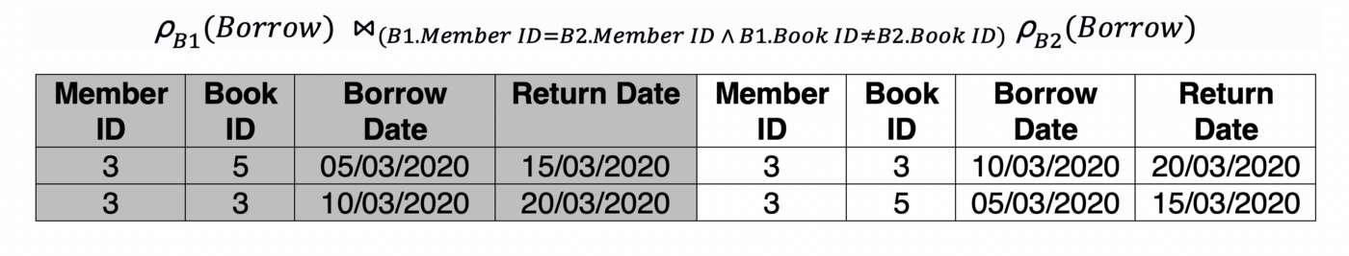
Conditional join (⋈c)
Query: Borrowing details of members who have burrowed more than one book.

Slide 30
Relational operators
Projection(π)
Selection (σ)
Rename (ρ)
Cross product (✕)
Natural join (⋈)
Conditional join (⋈c)
Union (⋃)
Intersection
Set difference

Slide 31
Union (⋃)
Union (⋃)
The union operation in RA is very similar to that of set theory.
However, for the union of two relations, both the relations must have the same set of attributes.

Slide 32
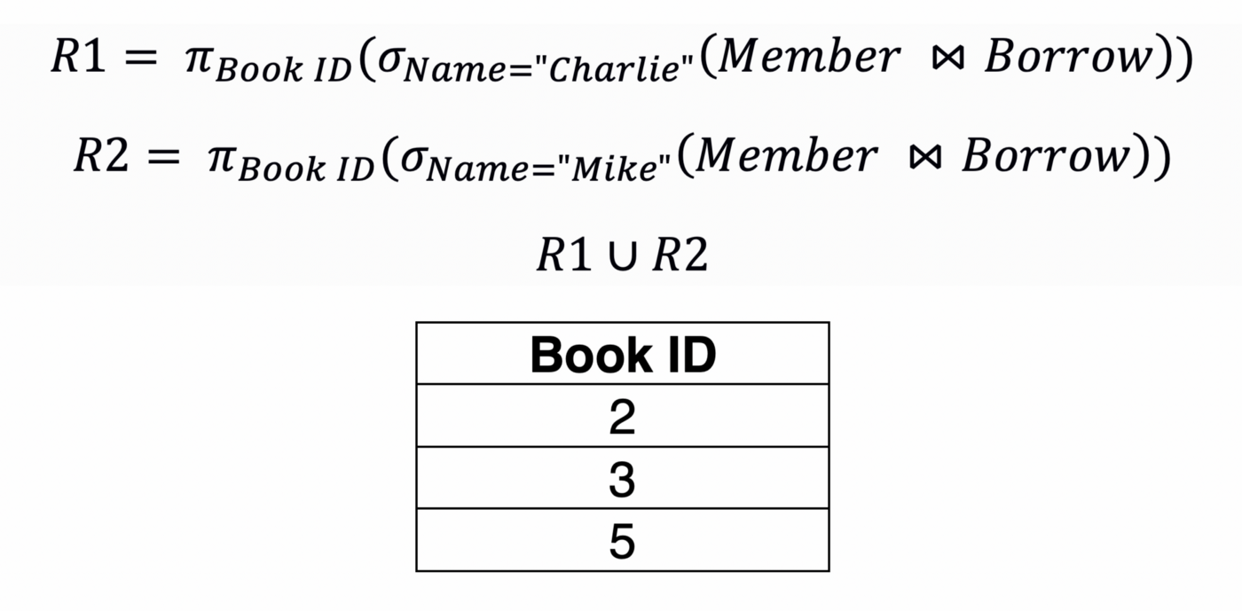
Union (⋃)
Query: Book IDs of the books borrowed by Charlie and Mike.

Slide 33
Relational operators
Projection(π)
Selection (σ)
Rename (ρ)
Cross product (✕)
Natural join (⋈)
Conditional join (⋈c)
Union (⋃)
Intersection (⋂)
Set difference

Slide 34
Intersection (⋂)
Intersection (⋂)
The intersection operation in RA is very similar to that of set theory.
However, for the intersection of two relations, both the relations must have the same set of attributes.

Slide 35
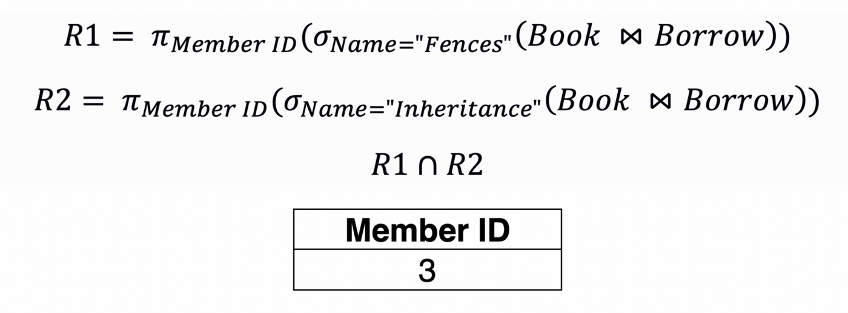
Intersection (⋂)
Query: Member IDs of the members who have borrowed both the books' “Fences” and “Inheritance”.

Slide 36
Relational operators
Projection(π)
Selection (σ)
Rename (ρ)
Cross product (✕)
Natural join (⋈)
Conditional join (⋈c)
Union (⋃)
Intersection (⋂)
Set difference (-)

Slide 37
Set difference (-)
Set difference (-)
The set difference operation in RA is very similar to that of set theory.
However, for the set difference between two relations, both the relations must have the same set of attributes.

Slide 38
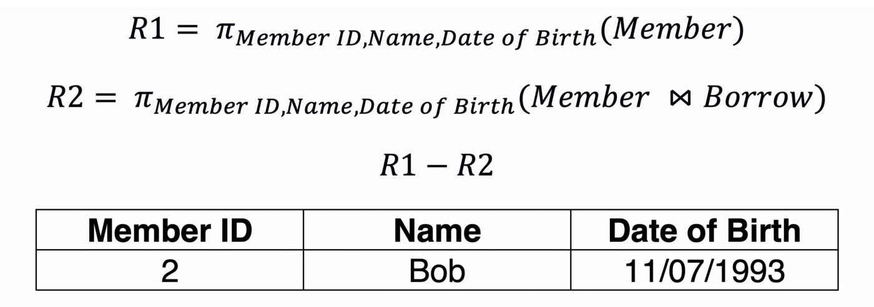
Set difference (-)
Query: Member IDs of the members who have never borrowed books.

Slide 39


